Slide 1




Web Framework Programming
Interactive UI Modal & Ajax with JQuery
WEEK 07 Informatics Engineering
Universitas Surabaya
Informatics Engineering | Universitas Surabaya
Notes:
Cover Half
Gambar vector bisa didownload di: https://scale.flexiple.com/illustrations/
Jika ingin foto free royalty bisa download di: https://pixabay.com/photos/

Slide 2
Outline
1
2
3
4
Modals UI
Ajax Concept
Ajax in Laravel
Implementing Ajax in a Dynamic Modal
Informatics Engineering | Universitas Surabaya

Slide 3
Modals UI
Informatics Engineering | Universitas Surabaya

Slide 4
What is Modal
A modal window is an element that sits on top of an application’s main window. It creates a mode that disables the main window but keeps it visible with the modal window as a child window in front of it. Users must interact with the modal window before they can return to the parent application. — Wikipedia
Example: https://getbootstrap.com/docs/4.0/components/modal/
Informatics Engineering | Universitas Surabaya

Slide 5
When we use modal ?
Grab the user’s attention
If you want to interrupt a user’s current task to catch the user’s attention to something more substantial.
Need user input
If you want to get information from the user. Ex. sign up or login form.
Show additional information in context.
If you want to show additional information without losing the context of the parent page. Ex. showing larger images or videos.
Show additional information (not in context)
If you want to show information that is not directly related to the parent page or other options that are “independent” from other pages. Ex. notifications.
Informatics Engineering | Universitas Surabaya

Slide 6
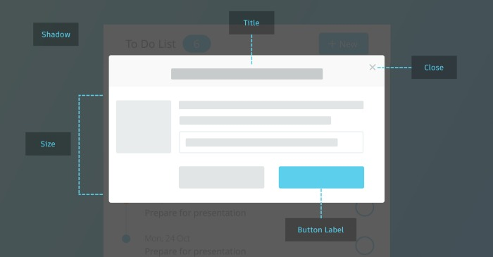
Modal Structure
Modal Content can be Static or Dynamic
For AdminLTE4, we use this link:
https://adminlte.io/themes/v3/pages/UI/modals.html
https://getbootstrap.com/docs/5.3/components/modal/
Informatics Engineering | Universitas Surabaya

Slide 7
We need additonal javascript or CSS based on child layout
For additional JavaScript or CSS, we can use @stack and @push syntax on Blade Template Laravel.
@stack('name'): This directive in your layout view defines a named stack, which is essentially an array where you can push multiple pieces of content. It will render all the items that have been pushed onto this stack.
@push('name') ... @endpush: This directive in a child view adds content onto the specified named stack. You can push individual strings or blocks of HTML/Blade code. Importantly, you can @push multiple times to the same stack from different parts of your views.
Informatics Engineering | Universitas Surabaya

Slide 8
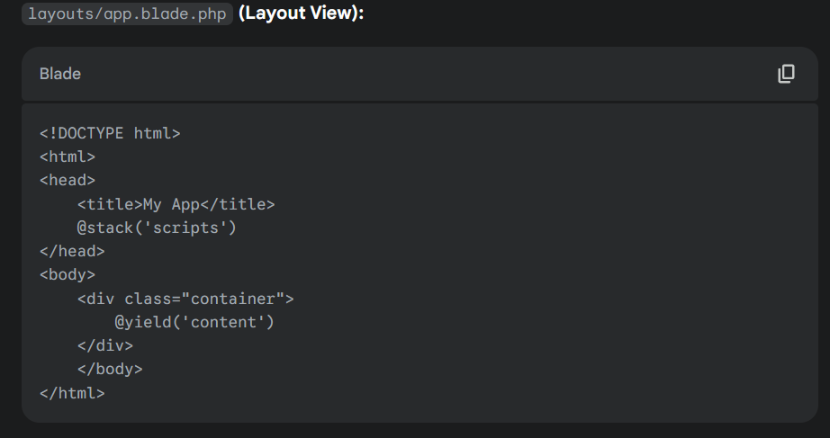
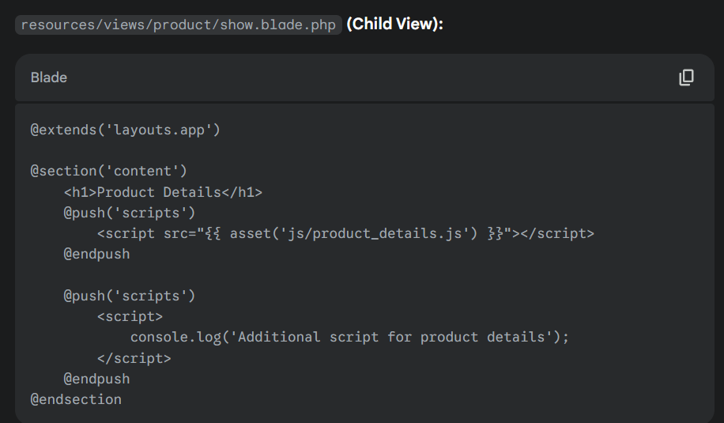
For information:
After Title tag, there are 2 scripts: (product_detail.js & console log)
We can put @push inside @section or after @endsection

Slide 9
What the differences between @yield/@section and @stack/@push
Feature | @section / @yield | @push / @stack
Purpose | Define and inject a single block of content. | Define a stack to accumulate and render multiple items.
Cardinality | One section in the child corresponds to one yield. | Multiple pushes can contribute to a single stack.
Replacement | Child section content replaces the yield's default. | Pushed content is added to the stack.
Use Cases | Defining layout parts (title, sidebar, main content). | Including multiple CSS/JS files or inline scripts.

Slide 10
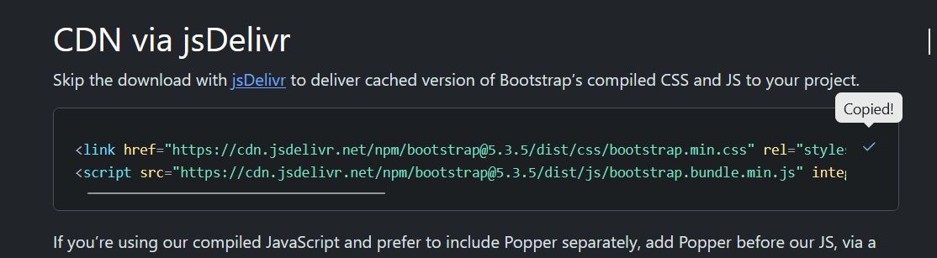
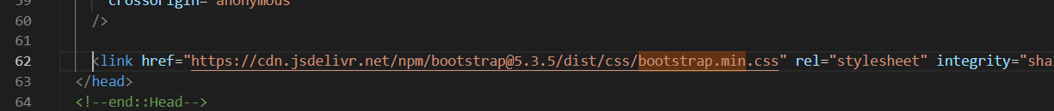
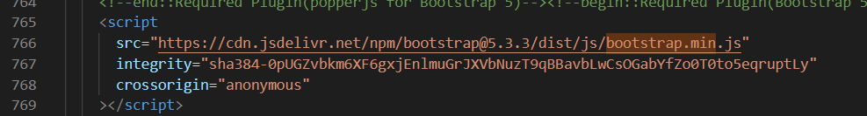
Make sure you have boostrap JS and CSS before execution
https://getbootstrap.com/docs/5.3/getting-started/introduction/
CDN links
As reference, here are our primary CDN links.
Description URL
CSS https://cdn.jsdelivr.net/npm/bootstrap@5.3.5/dist/css/bootstrap.min.css
JS https://cdn.jsdelivr.net/npm/bootstrap@5.3.5/dist/js/bootstrap.bundle.min.js
Check your layout (adminlte4)

Slide 11
Exercise #1 Showing Disclaimer - a simple static Modal in one page view
Informatics Engineering | Universitas Surabaya

Slide 12
Two section for modals construction
Button to trigger modals
Hidden Modal elements

Slide 13
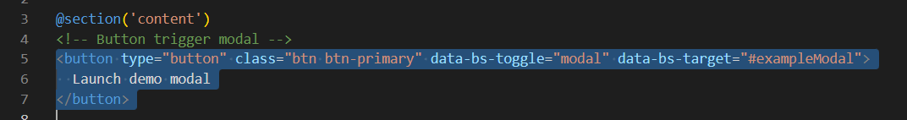
Modal Structure: Button
<button type="button" class="btn btn-primary" data-bs-toggle="modal" data-bs-target="#exampleModal">
Launch demo modal
</button>
Informatics Engineering | Universitas Surabaya

Slide 14
Modal Structure: Form Modal
<!-- Modal -->
<div class="modal fade" id="exampleModal" tabindex="-1" aria-labelledby="exampleModalLabel" aria-hidden="true">
<div class="modal-dialog">
<div class="modal-content">
<div class="modal-header">
<h1 class="modal-title fs-5" id="exampleModalLabel">Modal title</h1>
<button type="button" class="btn-close" data-bs-dismiss="modal" aria-label="Close"></button>
</div>
<div class="modal-body">
...
</div>
<div class="modal-footer">
<button type="button" class="btn btn-secondary" data-bs-dismiss="modal">Close</button>
<button type="button" class="btn btn-primary">Save changes</button>
</div>
</div>
</div>
</div>
*put anywhere in the section content. Please try inside `List of Categories(Index of Category)` view.
Informatics Engineering | Universitas Surabaya

Slide 15
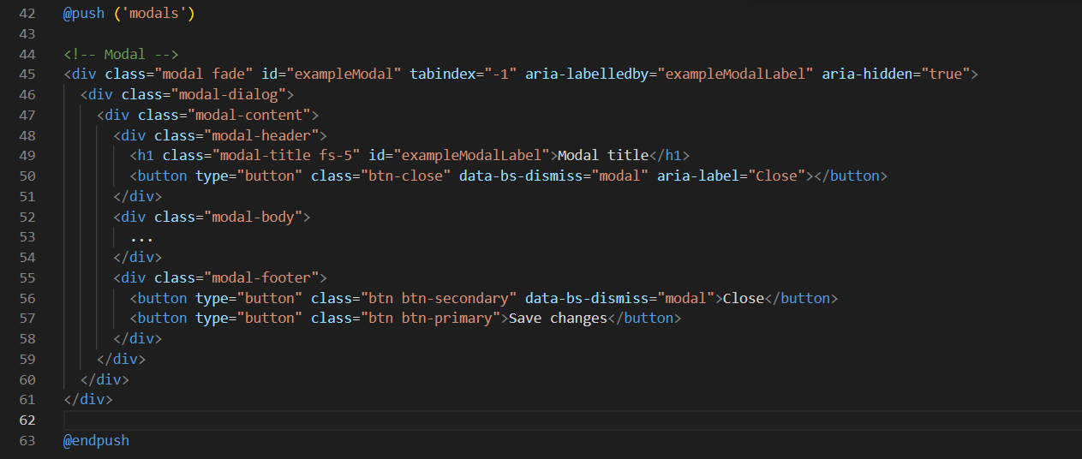

Slide 16
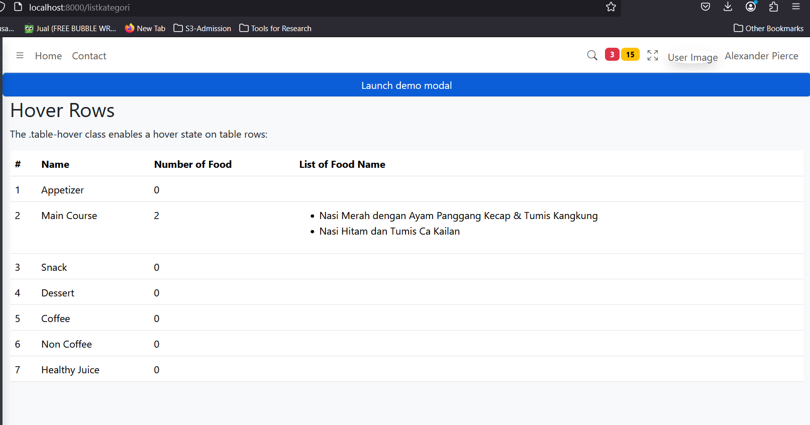

Slide 17
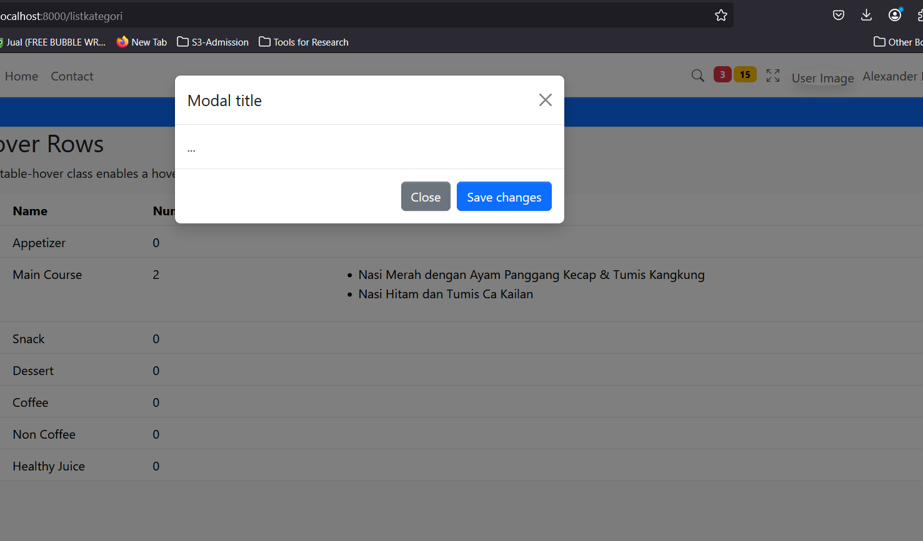

Slide 18
Exercise #2 Show Photo Product Category
Informatics Engineering | Universitas Surabaya

Slide 19
We use “storage” for images
https://laravel.com/docs/10.x/filesystem#the-public-disk

Slide 20
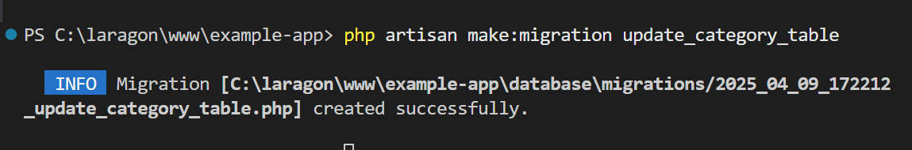
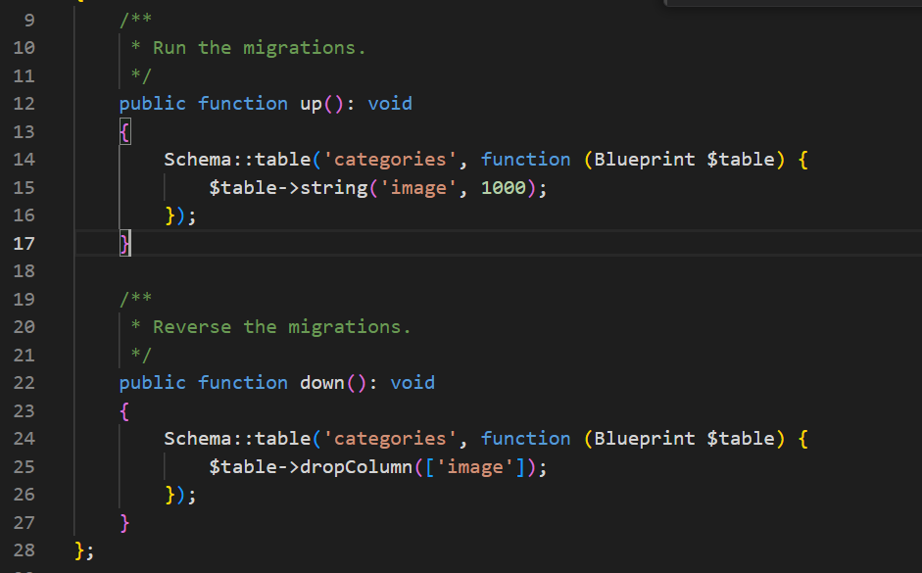
Pre-requirements
Make a migration update for add column image in category table.
php artisan make:migration update_category_table
Informatics Engineering | Universitas Surabaya

Slide 21
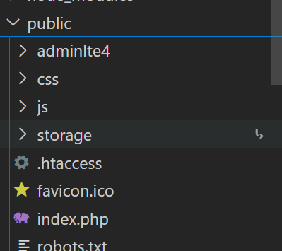
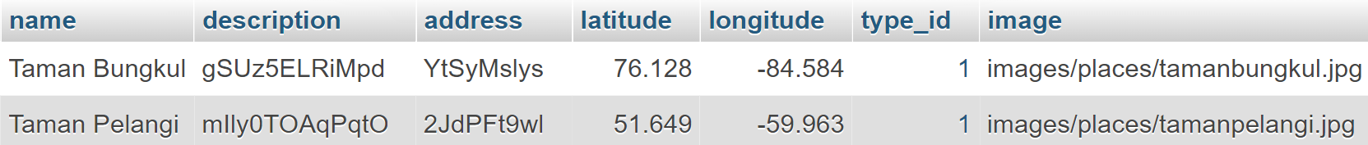
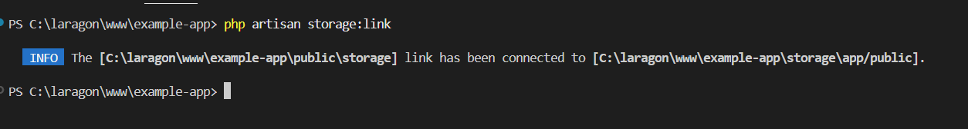
Pre-requirements (2)
Make a shortcut folder (symlink) from storage to public folder with: php artisan storage:link
Make new folder inside storage. Ex: category to store some images for each category data.
Don’t forget to update data in your database.
Informatics Engineering | Universitas Surabaya

Slide 22
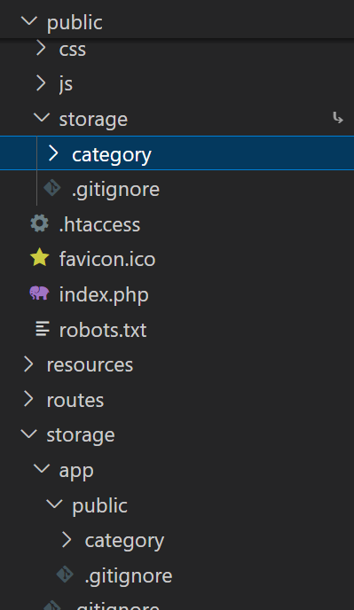
Symbolic Link (Symlink) is shortcut symbol that shared a references between public folder and storage folder.
If you make a directory inside public/storage, your new folder will be show up in your storage/app/public, and vice versa

Slide 23
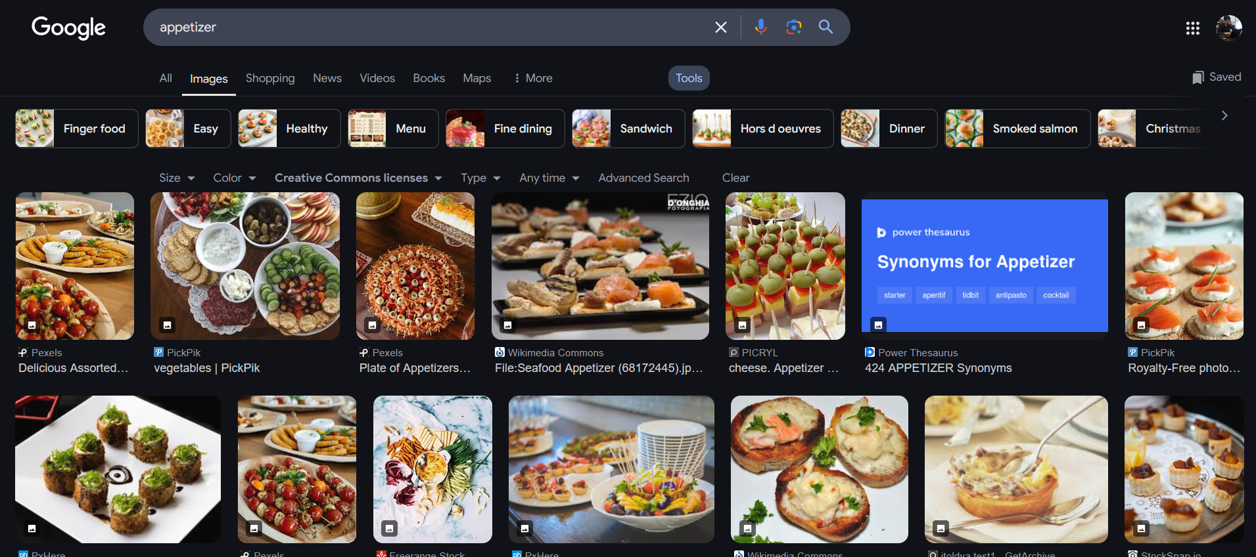
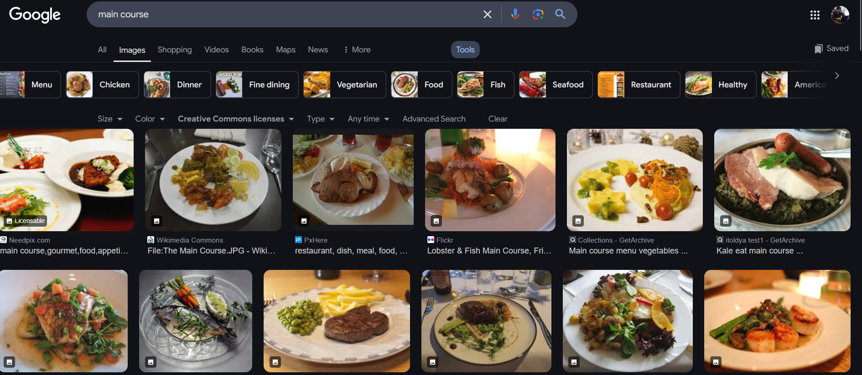
Pick 2 category first and download 1 image of it

Slide 24
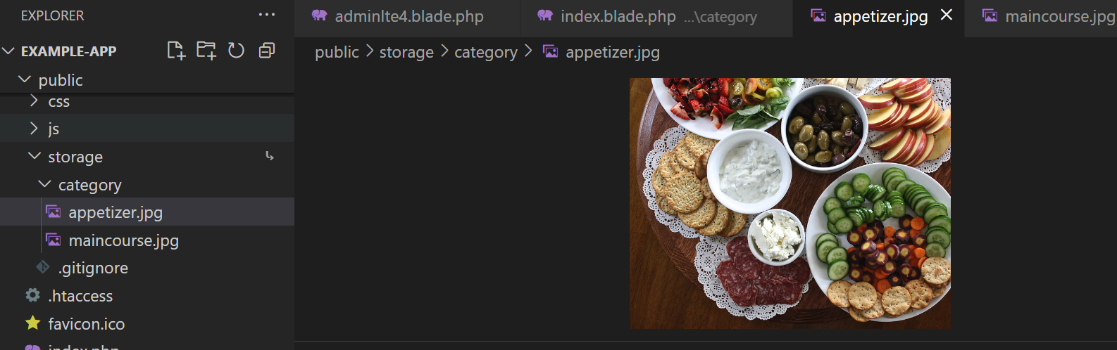

Slide 25
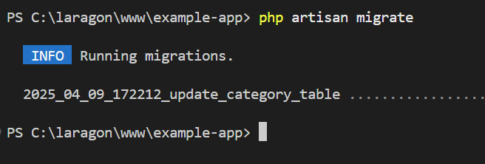
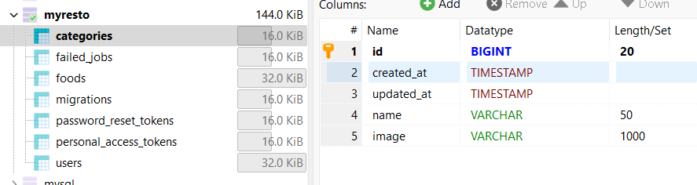
Migrate first

Slide 26
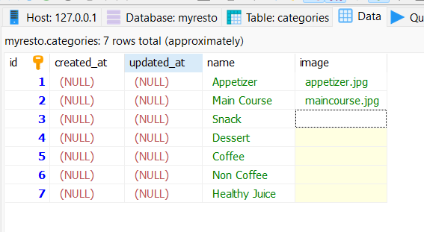
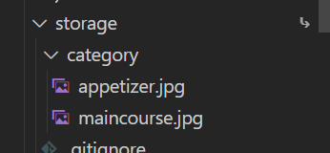
Insert your data based on your uploaded file

Slide 27
Using Static Modal
Create a dynamic modal form to access internal source(inside <td> data with a different ID). The modal content filled with images of the hotel and other information. Put the toggler button on each hotel record when looping the data.
Informatics Engineering | Universitas Surabaya

Slide 28
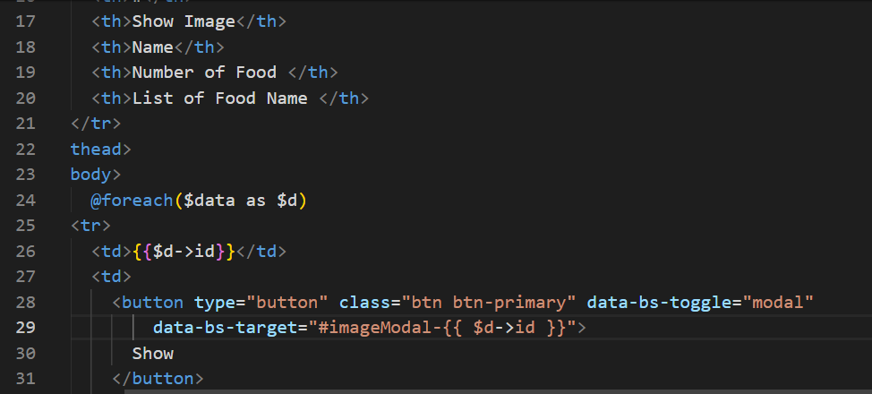
First, add new column and give an action to trigger modal “imageModal”
<button type="button" class="btn btn-primary" data-bs-toggle="modal"
data-bs-target="#imageModal-{{ $d->id }}">
Show
</button>

Slide 29
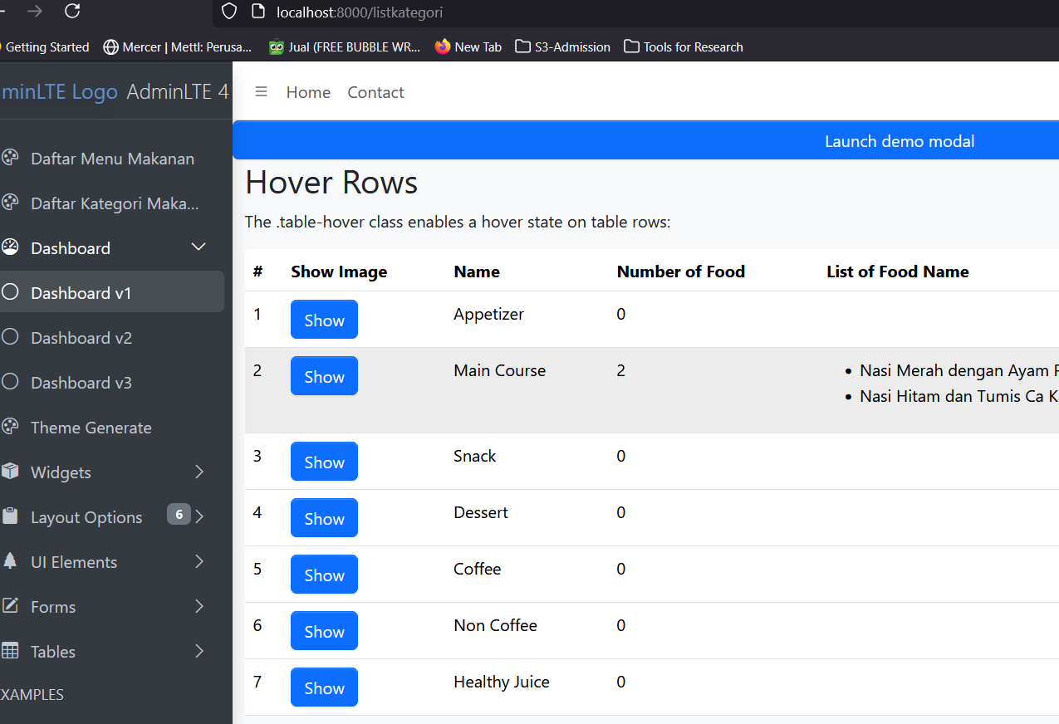

Slide 30
Second, implement Modal HTML
@push ('modals')
<!-- Modal {{ $d->id }} -->
<div class="modal fade" id="imageModal-{{ $d->id }}" tabindex="-1" aria-labelledby="imageModalLabel"
aria-hidden="true">
<div class="modal-dialog">
<div class="modal-content">
<div class="modal-header">
<h1 class="modal-title fs-5" id="imageModalLabel">Gambar untuk Kategori {{$d->id}} </h1>
<button type="button" class="btn-close" data-bs-dismiss="modal" aria-label="Close"></button>
</div>
<div class="modal-body">
{{ $d->id }} - {{ $d->name }}
</div>
<div class="modal-footer">
<button type="button" class="btn btn-secondary" data-bs-dismiss="modal">Close</button>
<button type="button" class="btn btn-primary">Save changes</button>
</div>
</div>
</div>
</div>
@endpush
Informatics Engineering | Universitas Surabaya

Slide 31
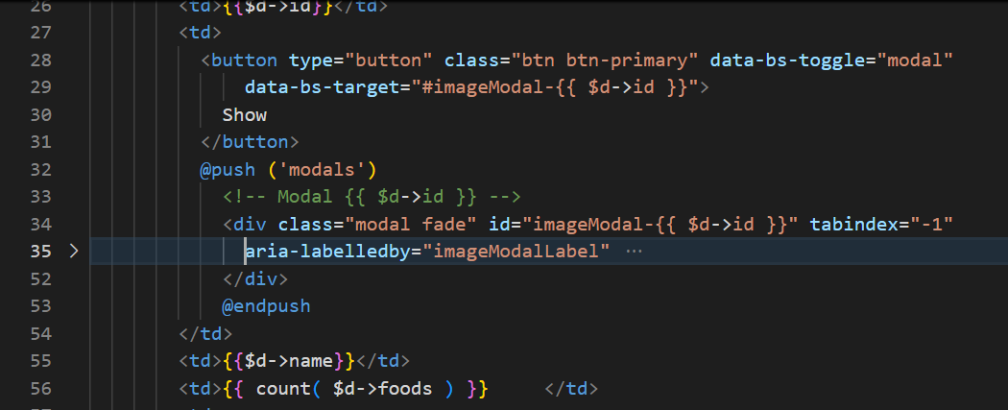
Notes
Use @push blade syntax
Put your @push and html modal near your button tag html
Modify your code based on your case study

Slide 32
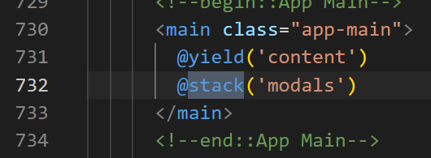
Don’t forget to insert @stack(‘modals’) in Your Layout

Slide 33
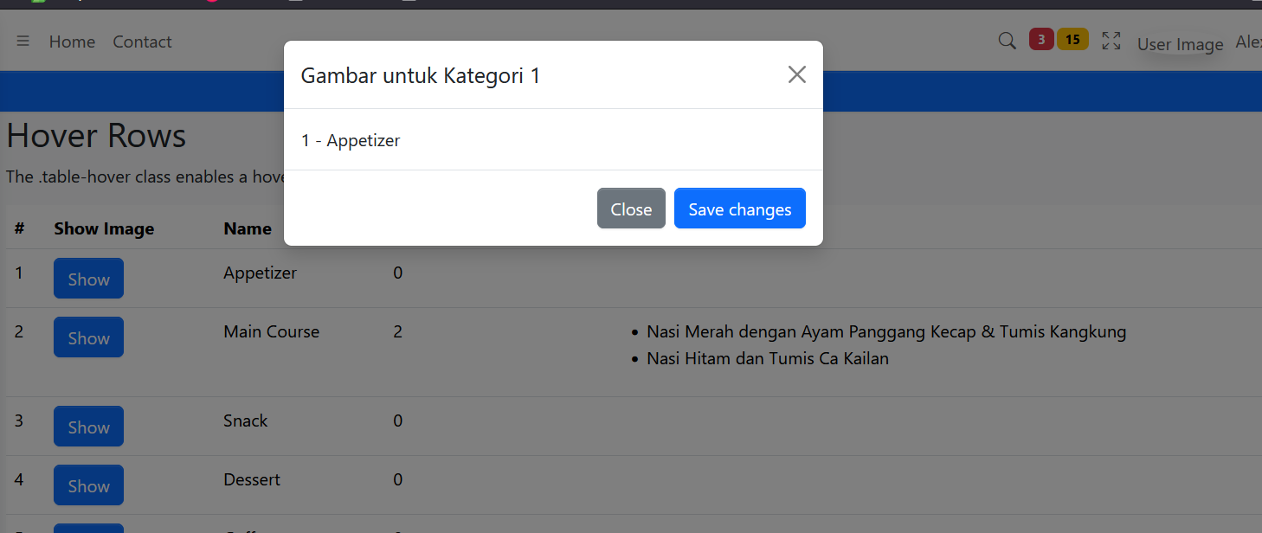
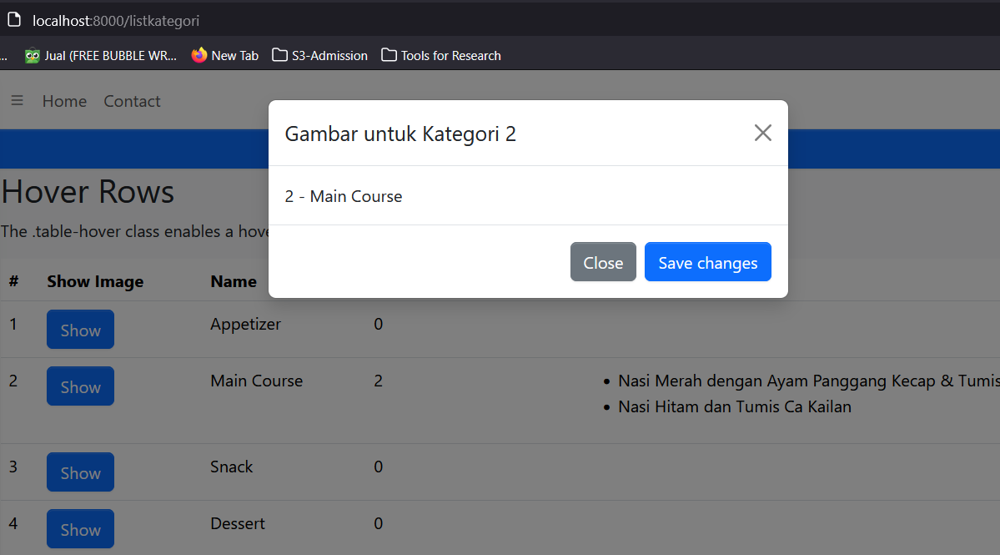

Slide 34
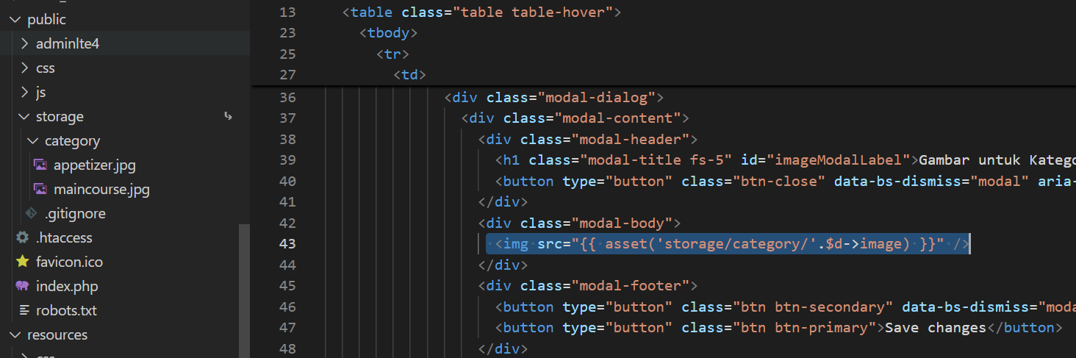
Modify your modals html with <img src>
Key point is “how to call image from storage?”. We use “asset” function and directly into public/storage
Informatics Engineering | Universitas Surabaya

Slide 35
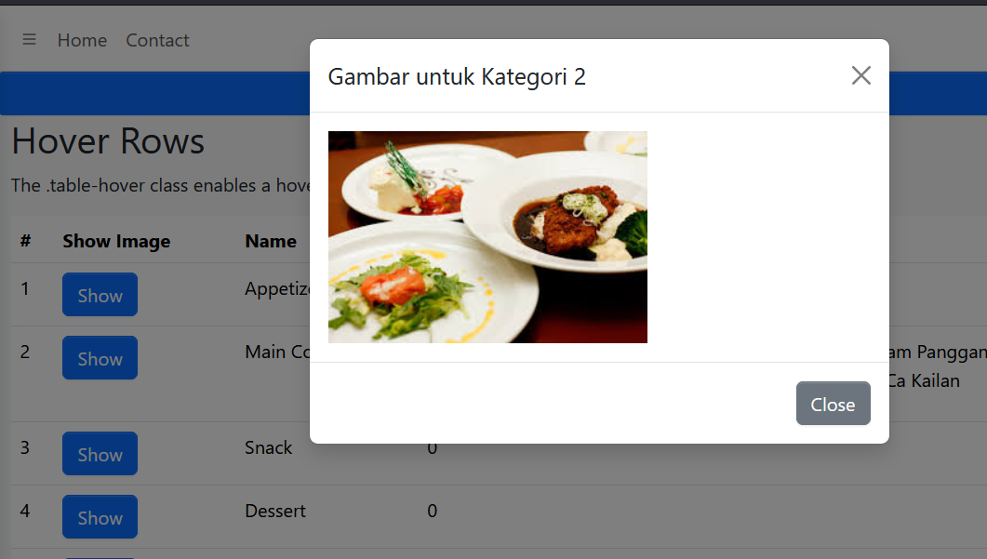
Result
Notes:
Don’t forget to remove “save button”
Make your image adaptive inside modal”
You can try this trick:
<img class="img-responsive" style="max-height:250px;" src="#" />
Informatics Engineering | Universitas Surabaya

Slide 36
AJAX Concept
Informatics Engineering | Universitas Surabaya

Slide 37
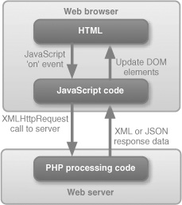
AJAX
AJAX (Asynchronous JavaScript and XML) is a set of web development techniques utilizing many web technologies used on the client-side to create asynchronous Web applications.
Import jquery library in your view file to use ajax functions of jquery which will be used to send and receive data using ajax from the server.
On the server side you can use the response() function to send response to client and to send response in JSON format you can chain the response function with json() function
Informatics Engineering | Universitas Surabaya

Slide 38
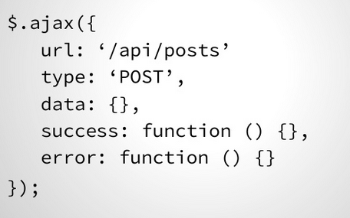
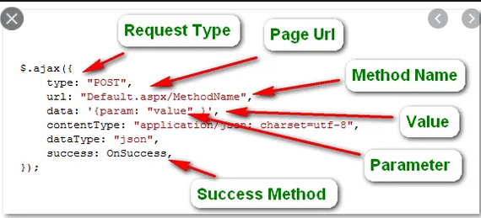
AJAX in View & Controller
Script JQuery AJAX is implemented in a view.
In a certain event handler , JQuery Ajax will request to spesific URL and will be accepted by Controller which next it will returning a json
The callback of JQuery ajax result will get the json, may be process it, and show it in a defined user interface
Informatics Engineering | Universitas Surabaya

Slide 39
Exercise #3 Using AJAX
Informatics Engineering | Universitas Surabaya

Slide 40
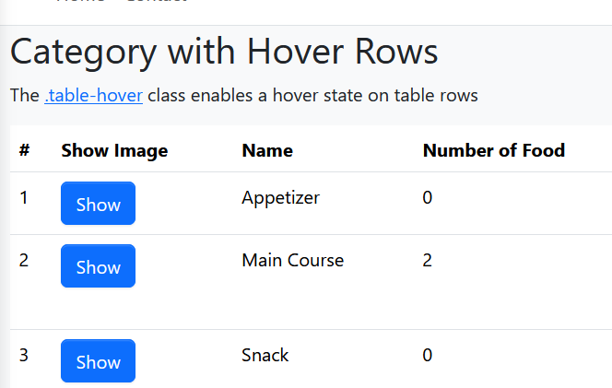
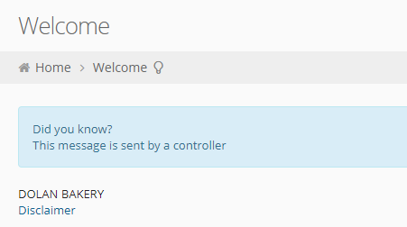
Exercise #3 : Show a simple message with AJAX
Informatics Engineering | Universitas Surabaya

Slide 41
Step
Add the link and its event which calling jquery AJAX
Code the above Javascript function, Define command HTTP, suggested a POST method (more secure)
Define route and the used Controller
Create the Controller
Informatics Engineering | Universitas Surabaya

Slide 42
1. EXAMPLE: Add the bulb icon and its event which calling jquery AJAX function in your view.
<h2>Category with Hover Rows</h2>
<p>The <a href="#“ onclick=“showinfo()”>.table-hover</a> class enables a hover state on table rows</p>
Informatics Engineering | Universitas Surabaya

Slide 43
2. Define Route and Modify Controller
Route::post("/category/showInfo",[CategoryController::class, 'showInfo'])->name("category.showInfo");
After this, we are going to use “category.showInfo” routes as the target url of our AJAX.
We will create the “showInfo” function in the CategoryController later.
Informatics Engineering | Universitas Surabaya

Slide 44
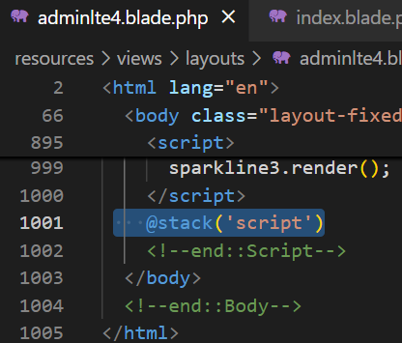
3. Code the javascript function
Code the function in the category.index blade, put the codes below in a section. Since we are using section with different name, so we need to prepare a yield inside the head element of the layout.
@push("script")
<script>
function showInfo() {
$.ajax({
type: 'POST',
url: '{{ route("category.showInfo") }}',
data: '_token=<?php echo csrf_token(); ?>',
success: function(data) {
$('#showinfo').html(data.msg);
}
});
}
</script>
@endpush
Add this in the parent layout at the end of Script section
Informatics Engineering | Universitas Surabaya

Slide 45
3. Code the javascript function : Explanation
@push("script")
<script>
function showInfo() {
$.ajax({
type: 'POST',
url: '{{ route("category.showInfo") }}',
data: '_token=<?php echo csrf_token(); ?>',
success: function(data) {
$('#showinfo').html(data.msg);
}
});
}
</script>
@endpush
JQuery ajax syntax is using $.ajax followed by these parameters:
type 🡪 command HTTP,
url 🡪 routing destination,
data 🡪 parameter/data that parsed to the route
success 🡪callback/action function that will execute when success
As default, Data transferred in the callback function is in a form of JSON
‘data.msg’ is a json object which will be generated by the Controller
It is a mandatory for using _token when using POST method
Informatics Engineering | Universitas Surabaya

Slide 46
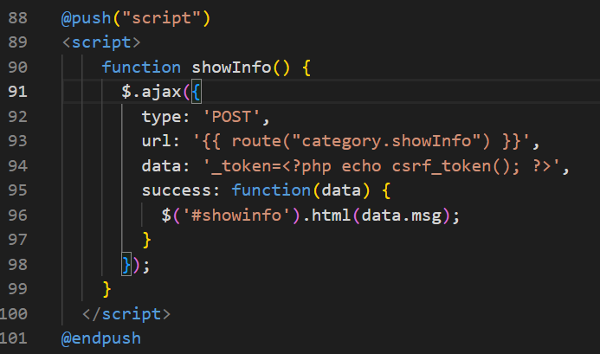
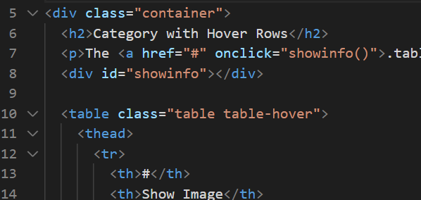
3. Code the javascript function : Implementation
Don’t forget to implement this section
Informatics Engineering | Universitas Surabaya

Slide 47
Exercise #4 Implement AJAX
Informatics Engineering | Universitas Surabaya

Slide 48
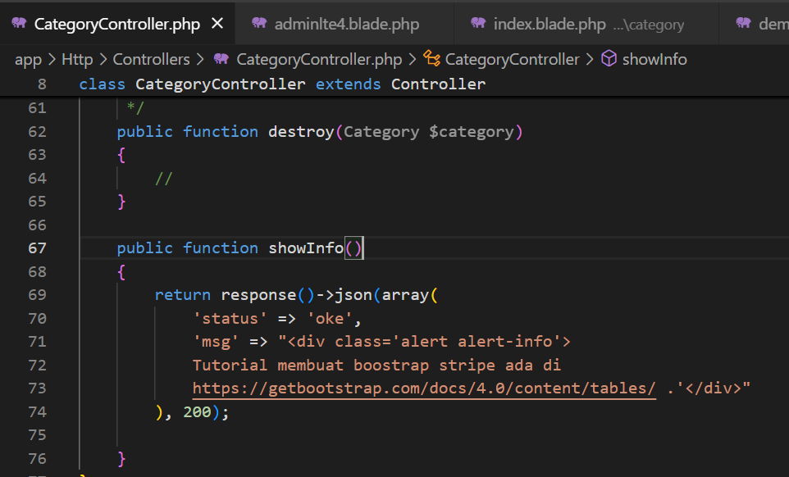

Slide 49
Don’t forget to add JQUERY JS before @stack(‘script’)
Please insert this code inside your Parent View (Layout)
<script src="https://ajax.googleapis.com/ajax/libs/jquery/3.7.1/jquery.min.js"></script>

Slide 50
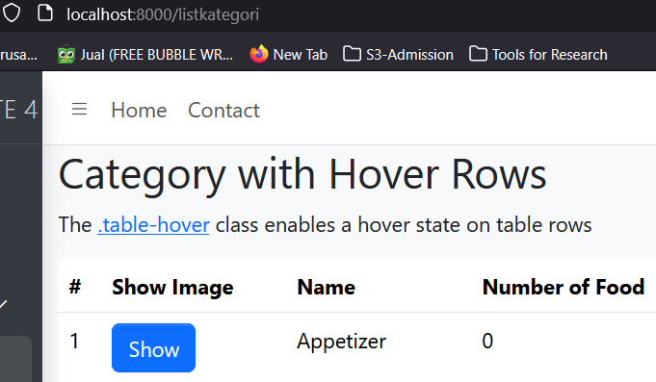
4. Implement showInfo function inside Controller
return response()->json(array(
'status' => 'oke',
'msg' => "<div class='alert alert-info'>
Tutorial membuat boostrap stripe ada di https://getbootstrap.com/docs/4.0/content/tables/ .'</div>"
), 200);
Place it in the CategoryController.
Use method response()->json() to create json data.
Data in array with some pairs of ‘key’ and ‘value’
Informatics Engineering | Universitas Surabaya

Slide 51
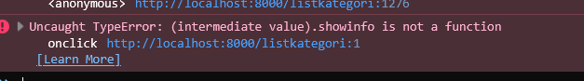
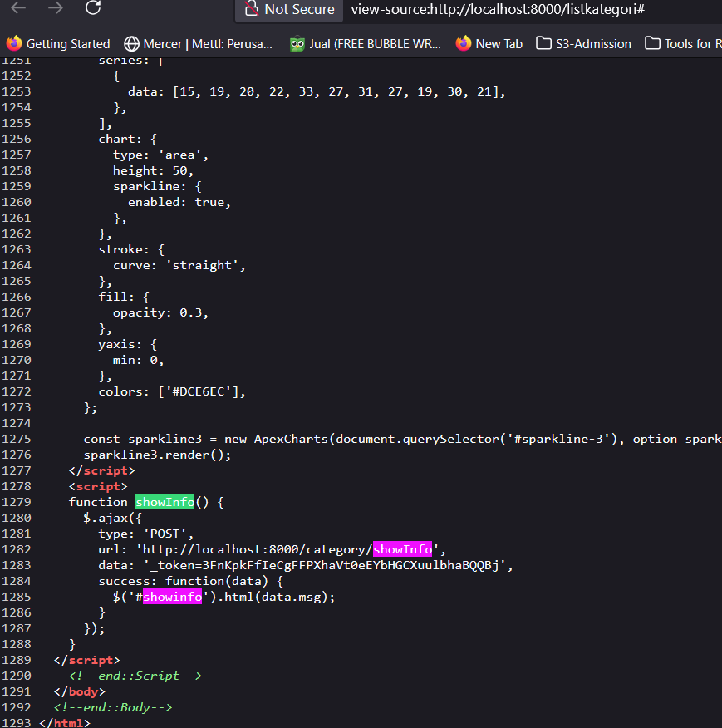
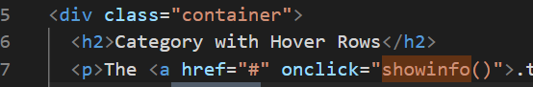
Issue error 🡪 Check your Javascript FIRST (Missing function name)
If you have an unresponsive action, please open: Right Click > Inspect Element > Console
If you have an error like this, please check your script code is already loaded or not. Use Ctrl+U instead
In this case, our code is wrong, because
function showInfo uses ‘s’ character lowercase and ‘I’ uppercase
But, programmer call with “showinfo” in onclick action

Slide 52
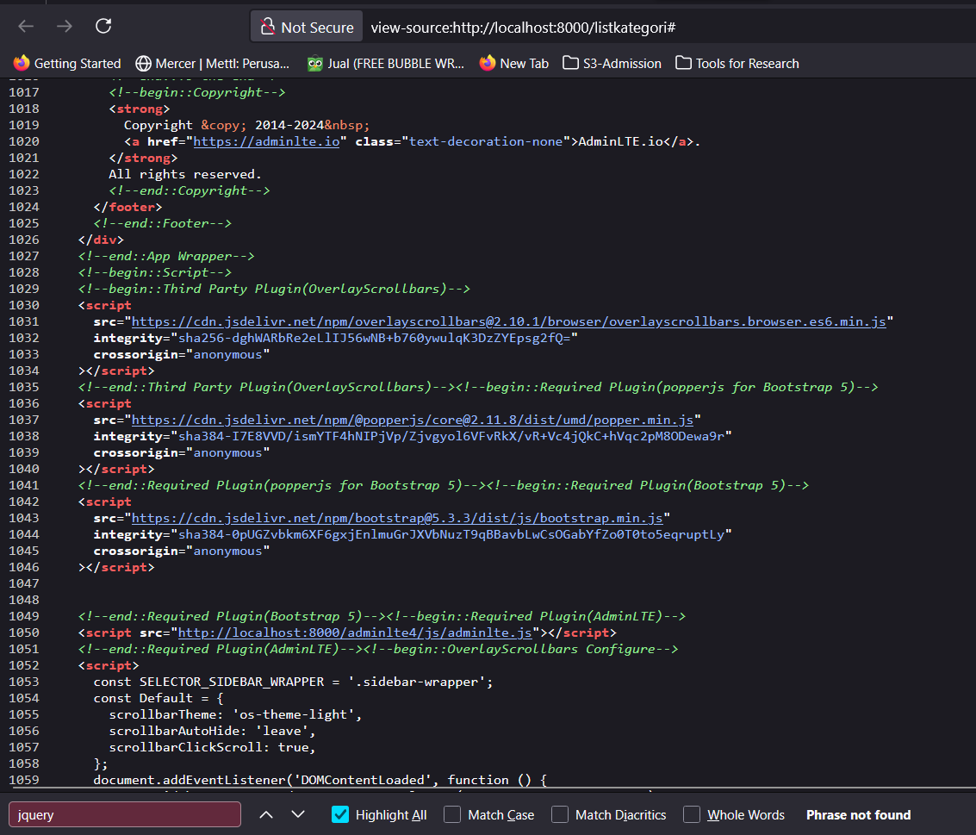
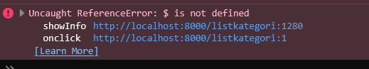
Issue error 🡪 Check your Javascript FIRST (Missing JQuery to understand $ syntax)
If you have an unresponsive action, please open: Right Click > Inspect Element > Console
If you have an error like this, please check your script code is already loaded or not. Use Ctrl+U instead
In this case, we have to check
JQuery JS is already loaded before we call ajax syntax
Use Find and type “Jquery”.
If there is no Jquery JS, please insert first inside your Layout Blade

Slide 53
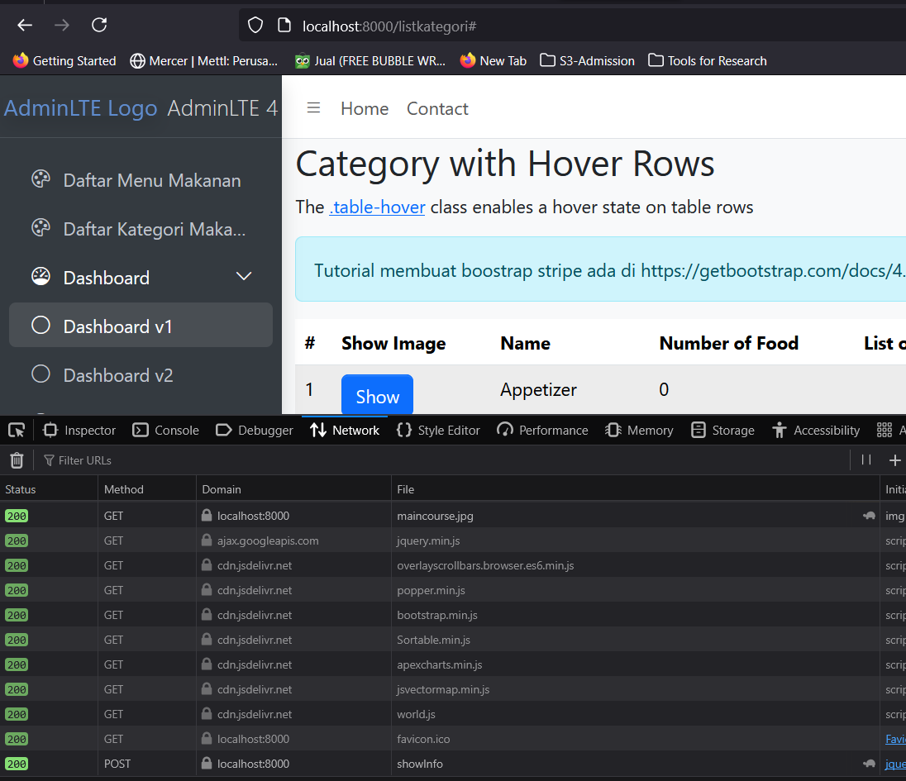
It’s visible to check AJAX Process
Inspect Element > Network
Refresh Again until you see all processes
Click link with Ajax
There is one request network based on your code.
If status 200, your request is completely successful. But if you have error, you need to inspect more deep

Slide 54
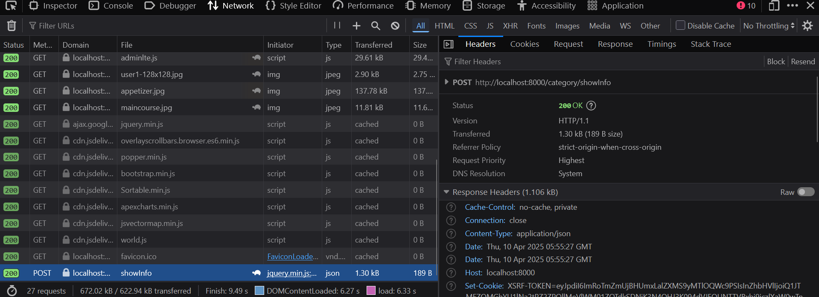

Slide 55
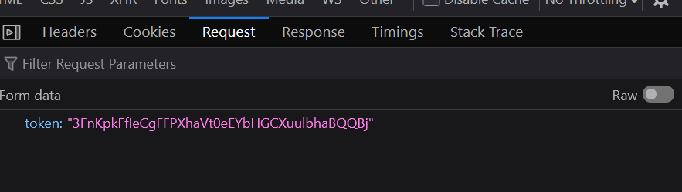
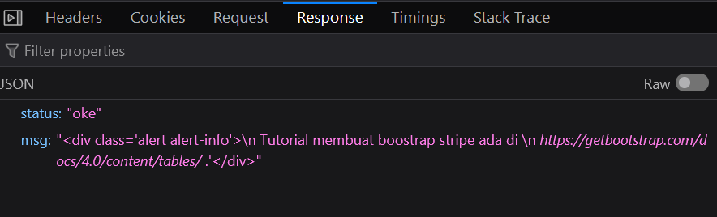

Slide 56


If you have 500 ERROR, so programmer must fix it.
Check deeper into “Request” and “Response”
In this case, programmer must check “Is there any wrong or typo between function name in Controller and function name inside Router?”

Slide 57


Slide 58

Exercise #4 : Add new action by reuse/modify exercise #3 to show the Category name where has the highest number of food variant
(in the future, when we already have a transaction, it can be changed with more useful information like the most selling product, etc)
Informatics Engineering | Universitas Surabaya

Slide 59


Slide 60

#4. Example for add query in new link
public function showInfo() {
$highestFoodCategory = Category::withCount('foods')
->orderByDesc('foods_count')
->first();
return response()->json(array(
'status' => 'oke',
'msg' => "<div class='alert alert-danger'>
The highest amount of food is <b>'".$highestFoodCategory->name.“</b></div>"
), 200);
}
Informatics Engineering | Universitas Surabaya

Slide 61
Exercise #5 Make a Modal for showing foods in master category (replace bullet point)
Informatics Engineering | Universitas Surabaya

Slide 62

We need to change this with modals for elevate the efficient of User Interface

Slide 64
1. Prepare : Blank Modal Form
Still in category/index.blade.php , we will create the modal header, modal body, and modal footer from a View, therefore we will clear the modal-content (or put with an animated loading gif)
@push ('modals')
<!-- Modal -->
<div class="modal fade" id="detailModal" tabindex="-1" aria-labelledby="detailModalLabel" aria-hidden="true">
<div class="modal-dialog">
<div class="modal-content">
<div class="modal-header">
<h1 class="modal-title fs-5" id="detail-title">List of </h1>
<button type="button" class="btn-close" data-bs-dismiss="modal" aria-label="Close"></button>
</div>
<div class="modal-body" id=”detail-body”>
...
</div>
<div class="modal-footer">
<button type="button" class="btn btn-secondary" data-bs-dismiss="modal">Close</button>
</div>
</div>
</div>
</div>
@endpush
Informatics Engineering | Universitas Surabaya

Slide 65


Slide 66

2. Add the Link and its event which calling jquery AJAX Function
<td>
<button type="button" class="btn btn-info" data-bs-toggle="modal"
data-bs-target="#detailModal“ onclick="showDetail({{ $d->id }} >
Details
</button>
…
</td>
Informatics Engineering | Universitas Surabaya

Slide 67


Slide 68


Slide 69
3. Define Route and Controller for AJAX Data
Route::post("/category/showListFoods",
[CategoryController::class, 'showListFoods'])
->name("category.showListFoods");
In the next step, we are going to use AJAX and redirect the data by using route ‘category.showListFoods’.
We need 1 parameter to know specific category, but we parse inside the AJAX. So we don’t to make required parameter inside Routing.
Don’t forget to create the function ‘showListFoods’ in CategoryController later.
Informatics Engineering | Universitas Surabaya

Slide 70

Check with: php artisan route:list

Slide 71

4. Code the javascript function
Code the function in the category.index blade, put the codes below in a section.
function showDetail(id) {
$.ajax({
type: 'POST',
url: '{{ route("category.showListFoods") }}’,
data: {
'_token': '<?php echo csrf_token(); ?>',
'idcat': id,
},
success: function(data) {
$('#detail-title').html(data.title);
$('#detail-body').html(data.body);
}
});
}
Informatics Engineering | Universitas Surabaya

Slide 72


Slide 73
5. Implement showListFoods inside CategoryController
public function showListFoods()
{
$category = Category::find($_POST['idcat']);
$name = $category->name;
$data = $category->foods;
return response()->json(array(
'status' => 'oke',
'title' => $name.' Food List',
'body' => view('category.showListFood', compact('name', 'data'))->render()
), 200);
}
Make sure you are already make relationship of category and foods
Render make json can accept html code
Informatics Engineering | Universitas Surabaya

Slide 74


Slide 75
6. Create a new View
Create in view\category\showListFood.blade.php
<ul>
@foreach ($data as $f)
<li>{{$f->name}}</li>
@endforeach
</ul>
You can try to run at this point to check whether the modal is running well and get the hotel name or not.
Informatics Engineering | Universitas Surabaya

Slide 76


Slide 77


Slide 78
Find any error ?
Debug your codes by accessing the console on your browser. You can access it through “Inspect Element”.
Check the Debugging Example to get more detailed tips on debugging.
Informatics Engineering | Universitas Surabaya

Slide 79
Thank You
Informatics Engineering | Universitas Surabaya

